Slide 1
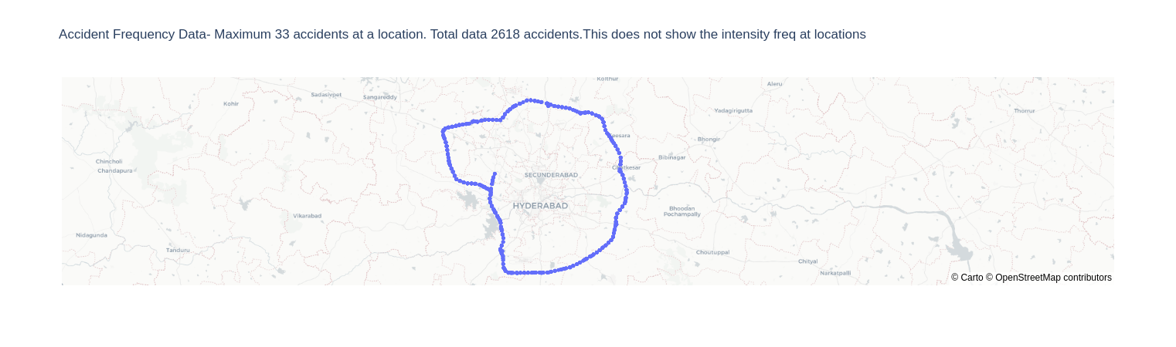
All accidents- 2618

Slide 2
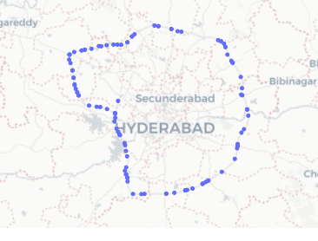
Fatal Accidents
84 unique fatal accident locations with 107 accidents

Slide 3
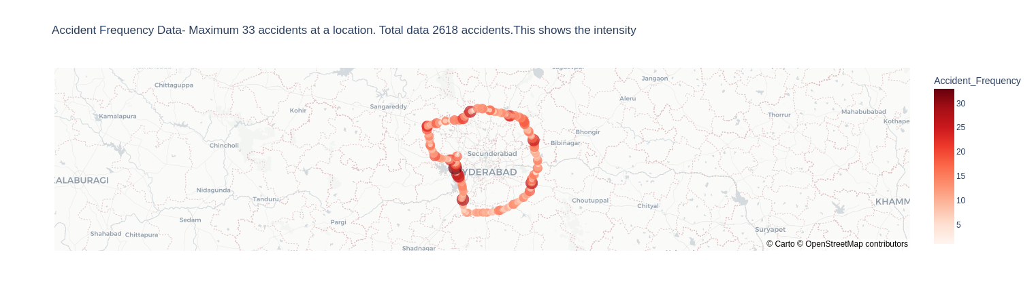
Accidents shown with intensity

Slide 4
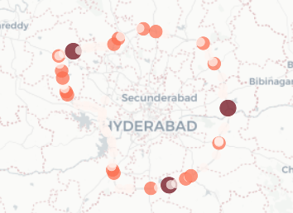
Fatal Accidents shown with intensity
Max Fatal accidents at a location is 3

Slide 5
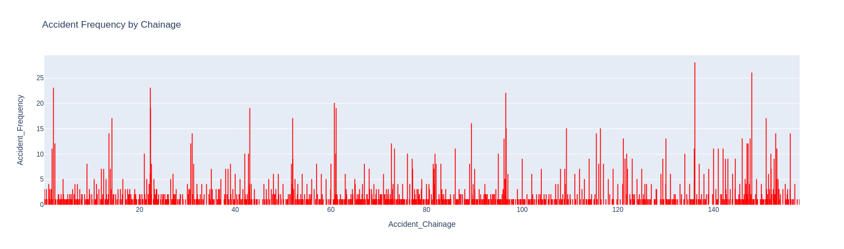
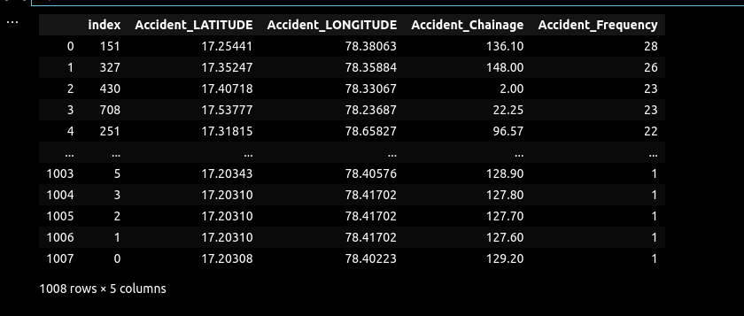
Countplot at chainage

Slide 6
Outliers
No outlier for 2*std dev.
Ideally- Total Acc.=Clustered Acc.
Using new data frame df_freq which has 1008 rows
df-2618
df_freq-1008

Slide 7
Clustering
Kmeans
DBSCAN
OPTICS
https://arxiv.org/abs/2108.03490- Reference Link

Slide 8
KMeans
Metrics used
1- Silhoutte Score- 0.75(max) at 25 Clusters
2-Davies-Bouldin Index- 0.2 (least) @ 27 clusters

Slide 9
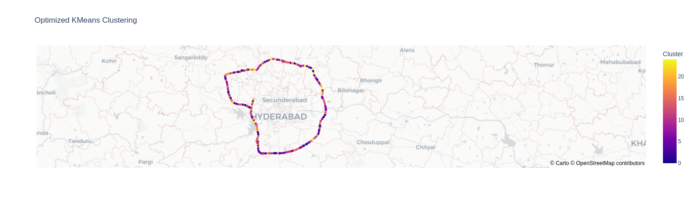
25 clusters based on (lat,lon,accident_freq) not useful since far spots clustered together- 1008 rows
Using only Lat,Lon for clustering on next slide

Slide 10
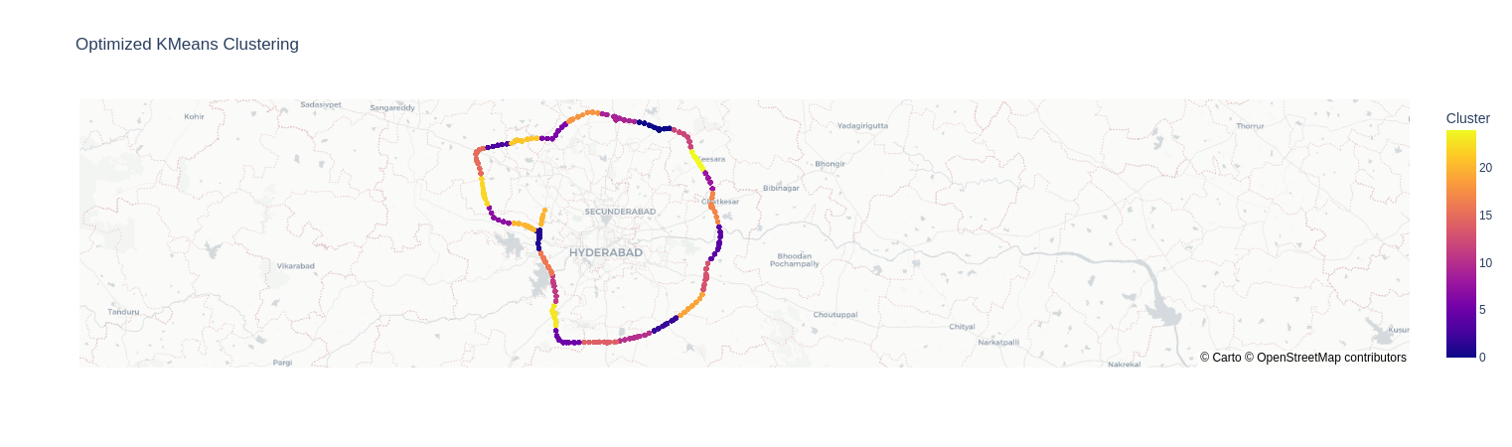
Selecting only Lat,Lon- 2618 rows- better clusters defined

Slide 11
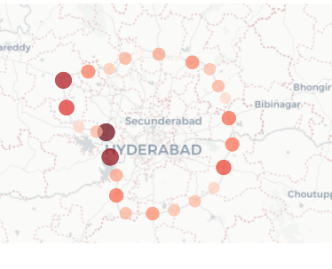
Kmeans- 26 DP with accident hotspot sum: 54-172
Note: We can remove overlapping DP and choose more accident spot as centroid

Slide 12
Using Fatal Accidents LatLOnFreq
Metrics used
1- Silhoutte Score- 0.75(max) at ~5 Clusters
2-Davies-Bouldin Index- 0.2 (least) @ ~4 clusters

Slide 13
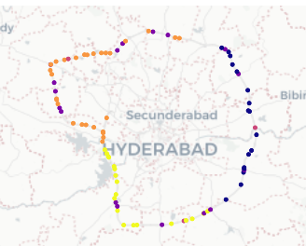
5 clusters based on (lat,lon,accident_freq) not useful since far spots clustered together- 84 rows
Using only Lat,Lon for clustering on next slide

Slide 14
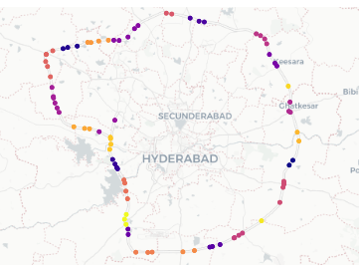
Selecting only unique Lat,Lon- 84 rows- better clusters defined- n_clusters=26
Well defined clusters for Lat Lon on 84 unique fatal accidents

Slide 15
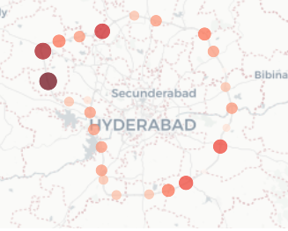
Kmeans- 26 DP with accident hotspot sum: 1-9
Left- All accidents Right-Fatal Accidents

Slide 16
DBSCAN
Metrics
1- Haversine used for distance on earth
2- epsilon-min_sample: Noise+Cluster Silhoutte Score
Epsilon= 0.000047 ~ 300m
min_sample= 3
number of clusters= 14
average silhouette score= 0.9417
Haversine Distance: This is the appropriate metric for spherical coordinates (latitude and longitude), taking into account the curvature of the Earth. It calculates the great-circle distance between two points on a sphere given their longitudes and latitudes.
https://stackoverflow.com/questions/34579213/dbscan-for-clustering-of-geographic-location-data

Slide 17
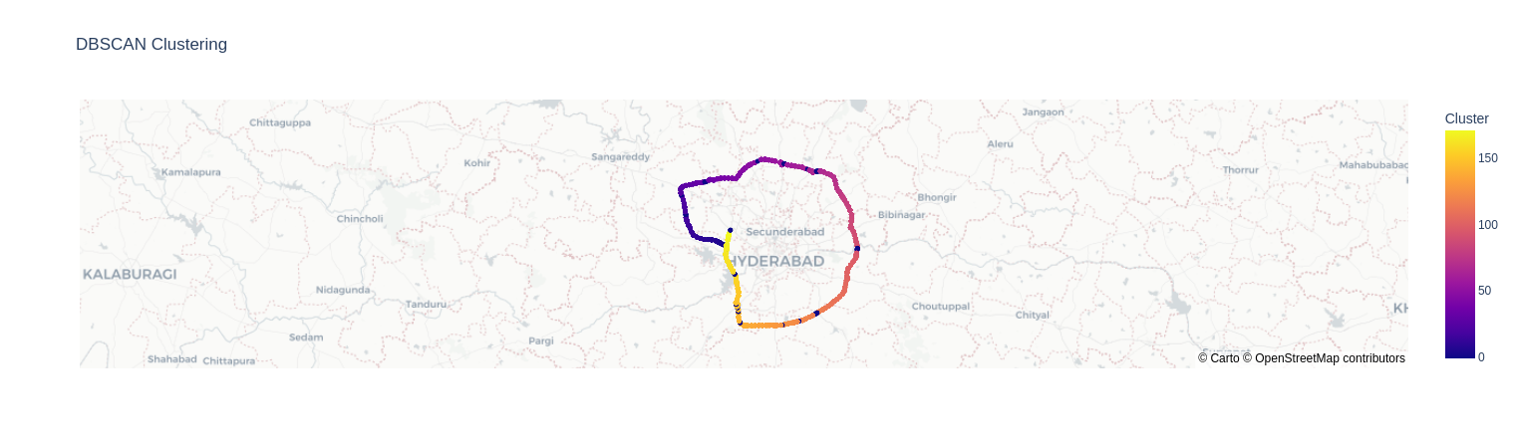
Test-1 epsilon =300m, min_sample=5
Used df_latlon- 2618 rows with n,m... lat lon-- not unique

Slide 18
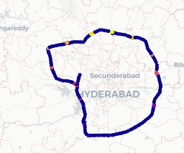
Used df_freq_dbscan with unique lat lon plus Accident freq-- 268 locations
14 clusters which look relevant and clustered close: epsilon- 300m min_sample=3

Slide 19
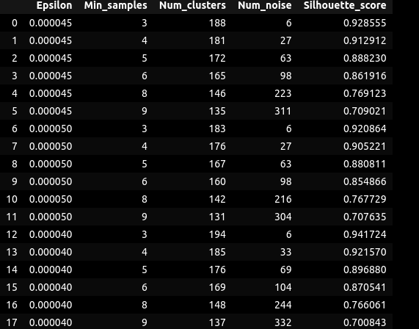
Optimisation DBSCAN
1- Silhouette Score
epsilon=[0.000045,0.000050, 0.000040]
min_samples=[3,4,5,6,8,9]
The result:
epsilon= 4e-05
min_sample= 3
number of clusters= 194
average silhouette score= 0.9417
2- Z-value max (as given in paper)
z_score = (num_clusters - num_noise) / np.sqrt(num_clusters + num_noise)
Optimal Result:
np.float64(4.5e-05) ~ 300m
Conclusion:
Epsilon= 0.000045
min_sample=3

Slide 20
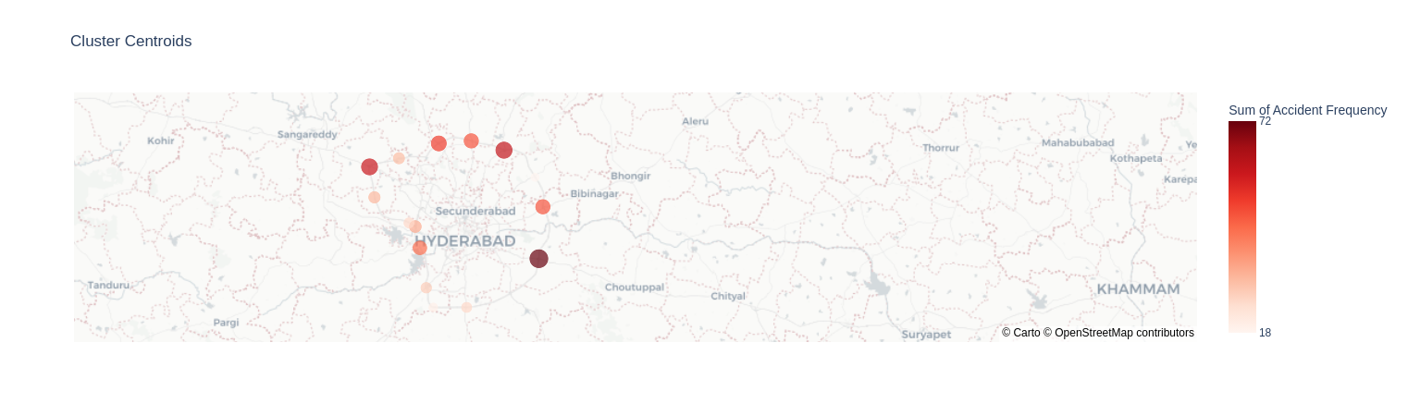
14 Clusters-with centroid demand points and sum of accidents (max=59~60)

Slide 21
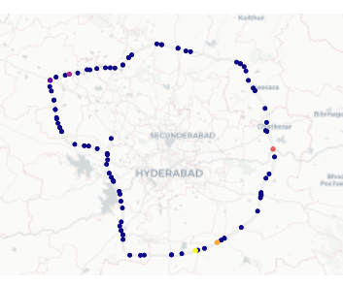
epsilon =200m, min_sample=3
Used df_latlon- 2618 rows with n,m... lat lon-- not unique
Max. Fatal points are clustered as outliers -1, tweaked parameters but same

Slide 22
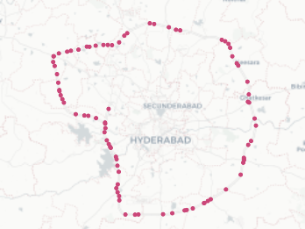
Used df_freq_dbscan with unique lat lon plus Accident freq-- 84 locations
1 cluster which epsilon- 200m min_sample=3

Slide 23
Why is DBSCAN not clustering well?
Earlier, the dataset was uniformly distributed all accidents were accross highways
Fatal accidents are spaced at some distance and less data points
So, fatal points far off no closer to each other considered as Outliers
Conclusion- we can try Kmeans since better clustering

Slide 24
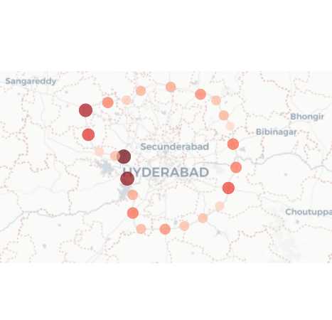
Kmeans Cluster vs DBSCAN
Kmeans- 25 clusters Hotspot range 54-172
DBSCAN- 14 clusters Hotspot range 20-70

Slide 25
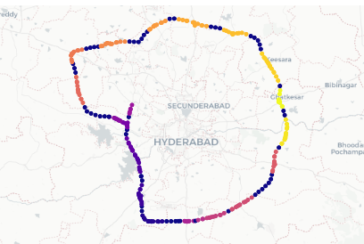
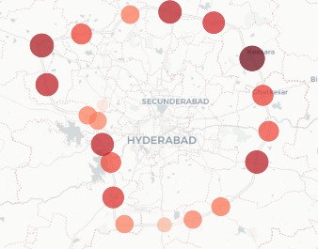
OPTICS- Robust than DBSCAN
Optics test1 gave 20 clusters with Accident sum range of centroids ranging from 18 to 145

Slide 27
Kmeans | DBSCAN | OPTICS
 | KMeans | DBSCAN | OPTICS
No. of Clusters | 25 | 14 | 20
Accident Sum Range | 54-172 | 18-72 | 18-145
Optimisation | Silhoutte Score, Elbow Point | Silhoutte Score, Z-score
Parameters | n_clusters=25 | e=300m, min_sample=3 | Xi=0.05 min_sample=5 min_cluster_size=3
Methodology
Conclusion: OPTICS dp= 20 should be choosen
Why?

Slide 28
